Slide 1
Generation Forecasting Error modelling for Spanish Electricity Grid
Muhammad Adil Saleem

Slide 2
Formatting and Cleaning
Spanish Electricity Data from ENTSO-E Transparency Platform
Time period 01-01-2024 to 21-02-2025
15 minutes data interval and 1 hour interval data
Problems and Difficulties:
ENTSO-E Transparency Platform was not accessible in Pakistan
Website response was very slow due to use of VPN
Overall, the data resource is wealthy and comprehensive.
Only include electricity market-related data.

Slide 3
Variables and Format
Variables | Time Interval | Transformation | Missing values
Actual Generation | 15 Mins | Summation across types | Yes
Scheduled Generation | 15 Mins | None | Yes
Actual Total Load | 15 Mins | None | Yes
Day-ahead load forecast | 15 Mins | None | Yes
Day -ahead Prices (EDP) | 1 hour | Same value for successive 30 Mins | No
Generation Forecast Error (GFE) | 15 Mins | Actual - Forecast Gen | Yes
Load Forecast Error (LFE) | 15 Mins | Actual - Forecaste Load | Yes
Weekend (Dummy) | 30 mins | 1= weekend; 0 otherwise
Peak.Weekday (Dummy) | 30 Mins | 1 = peak time; 0 otherwise

Slide 4
Data Aggregation/ Dealing with missing values
The whole data is transformed into 30-minute interval
15 minutes of data was aggregated by simple summation to transform it into 30 minutes (GFE, LFE)
1 hour data was duplicated for each 30 minutes within an hour (EDP)
Data was missing for some generation types (ignored)
Data was missing for one hour on 31.03.2024 between 02:00- 0300
GFE and LFE (missing for one hour)
Four-point moving average (remedy)
Variable of interest are stationary at levels by ADF test (see python script)

Slide 5
Potential variables
Temperature
Industrial Production (economic activity)
European Grid is integrated (Intercontinental electricity flow)

Slide 6
What is more suitable variable of interest
Day ahead generation forecast
Day ahead load forecast
Generation Forecast error is coming from the difference between actual generation and total generation
If the load is correctly forecasted, generators will be able to adjust more efficiently thus minimising the GFE
GFE loses seasonal and trend components, leaving us with little to manage the complications (Heteroscedasticity)

Slide 7
Objectives of econometrician
What causes what? What causes GFE?
More interested in causal relationships
Inferential Statistics
Forecasting
Only interest is finding the best predictive model

Slide 8
Before starting time series analysis
GFE, LFE and EDP is stationary at levels (No transformation needed)
For optimal lag length (Box-Jenkins Methodology)
Autocorrelation function (ACF)
Partial autocorrelation function (PACF)
AIC, BIC lag selection criteria

Slide 9
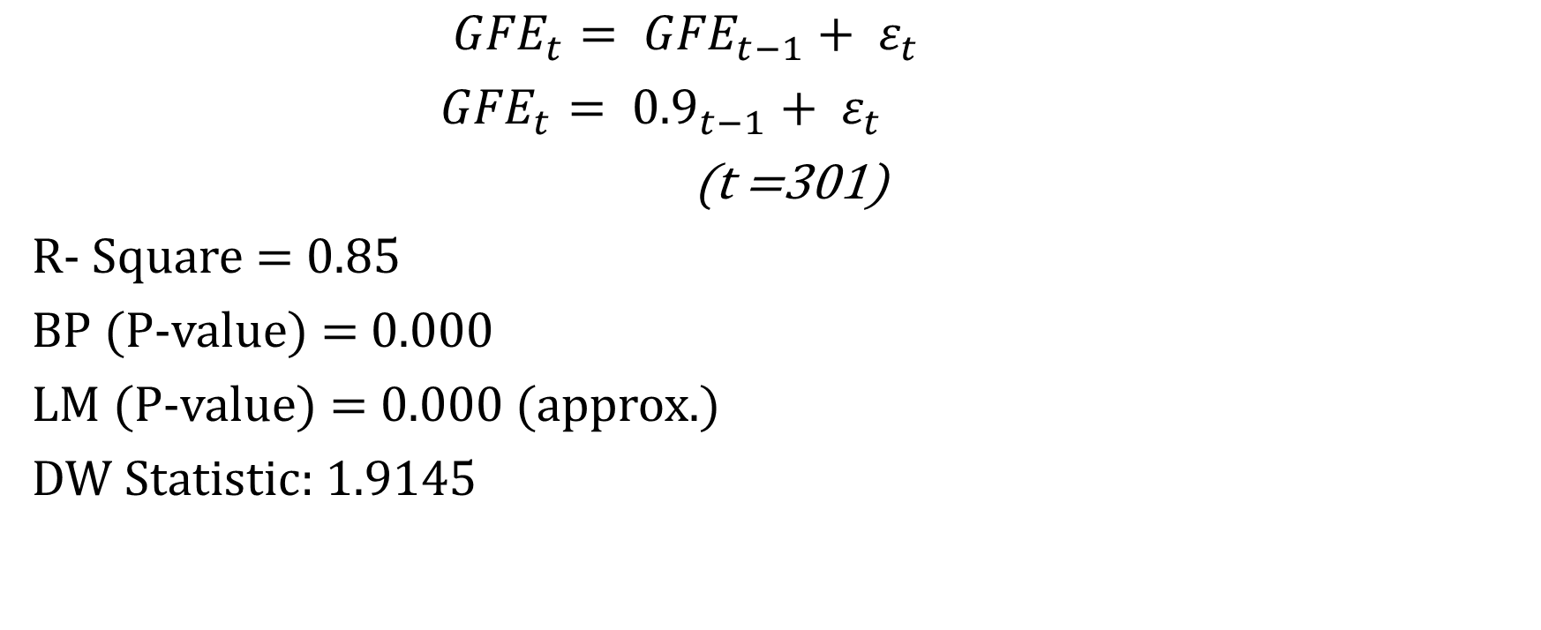
AR(1) model: The Benchmark Model
${GFE}_{t}= {GFE}_{t−1}+ ε_{t}$
${GFE}_{t}= {0.9}_{t−1}+ ε_{t}$
(t =301)
R- Square = 0.85
BP (P-value) = 0.000
LM (P-value) = 0.000 (approx.)
DW Statistic: 1.9145

Slide 10

Static Model (conditional model)
$${GFE}_{t}= β_{0}{+β_{1}GFE}_{t}+ {β_{2}LFE}_{t}+{β_{3}EDP}_{t}+β_{4} {weekend}_{t}{+β_{5}{peak.weekday}_{t}+ε}_{t}$$
It is called conditional model, because ${GFE}_{t+1}$ is based on the condition that values of ${LFE}_{t+1}$ and ${EDP}_{t+1}$

Slide 11
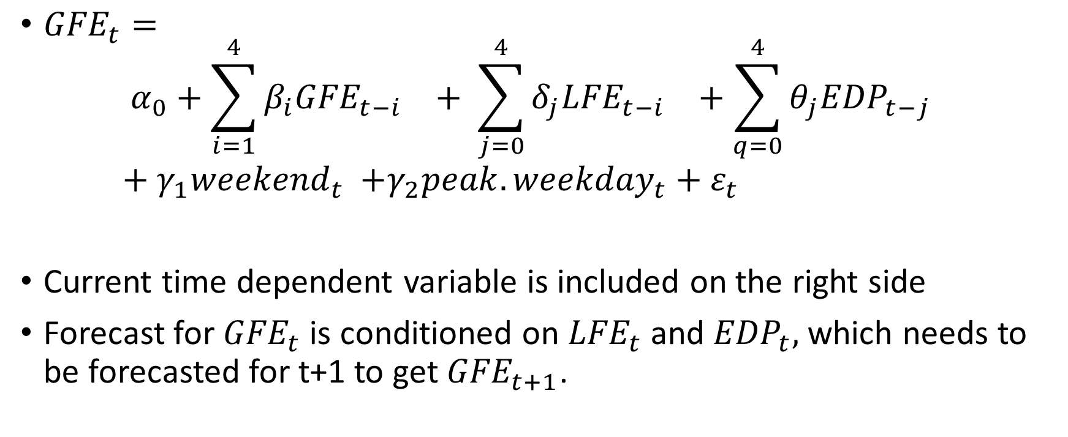
ARDL (4) Conditional
${GFE}_{t}=$
$${α_{0}+\sum_{i=1}^{4}{β_{i}{GFE}_{t−i}}}_{}+ {\sum_{j=0}^{4}{{δ_{j}LFE}_{t−i}}}_{}+{\sum_{q=0}^{4}{{θ_{j}EDP}_{t−j}}}_{}+γ_{1}{weekend}_{t} {+γ_{2}{peak.weekday}_{t}+ε}_{t}$$
Current time dependent variable is included on the right side
Forecast for ${GFE}_{t}$ is conditioned on ${LFE}_{t}$ and ${EDP}_{t},$which needs to be forecasted for t+1 to get${ GFE}_{t+1}$.

Slide 12
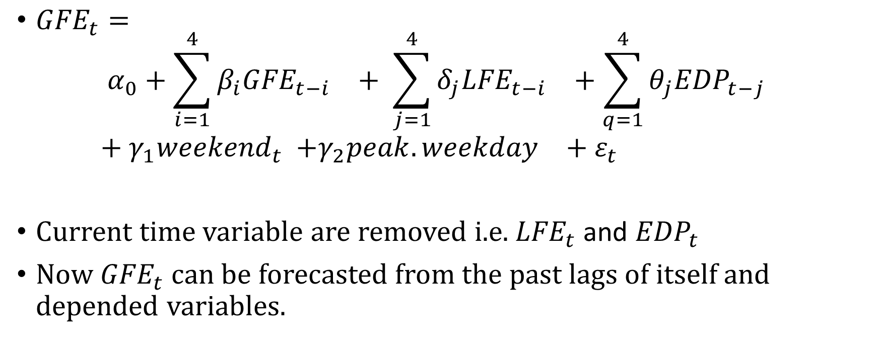
ARDL 4 Unconditional
${GFE}_{t}=$
$${α_{0}+\sum_{i=1}^{4}{β_{i}{GFE}_{t−i}}}_{}+ {\sum_{j=1}^{4}{{δ_{j}LFE}_{t−i}}}_{}+{\sum_{q=1}^{4}{{θ_{j}EDP}_{t−j}}}_{}+γ_{1}{weekend}_{t} {+γ_{2}{peak.weekday}_{}+ε}_{t}$$
Current time variable are removed i.e. ${LFE}_{t}$ and ${EDP}_{t}$
Now ${GFE}_{t}$ can be forecasted from the past lags of itself and depended variables.

Slide 13
Comparing AR(1) with ARDL (4) Unconditional
Statistic | AR(1) | ARDL(4) Unconditional Model
R-Square | 0.85 | 0.919
BP (Prob) | 0 | 0
LM(Prob) | 0 | 0
Durban Watson | 1.194 | 1.9143
RMSE (in sample forecast) | 1067.02 | 687.62

Slide 14
Other models performance
Model | RMSE
AR(1) | 1067.02
Static Model | N/A
ARDL (4) conditional | 678
ARDL (4) Unconditional | 687.62
ARMA(1,1) | 2645
ARMA(4,1) | 2646
ARMAX (4,1) | 2579
VAR (4) | 2647

Slide 15
Final word on competing models
As RMSE for ARDL(4, conditional) is minimum. We will not opt it for our forecasting.
The second lowest RMSE is of the ARDL (4, unconditional) model.
Therefore, in this model selection exercise ARDL(4, unconditional) performs well and can be used for causal effects(statistical inference) and forecasting.
Model selection is an art. There is no true model of any data- generating process, but we can search for a better one.

Slide 16
Model limitations and improvements
More data
Forecasting efforts should be directed at Generation and Load Forecast (not it’s error)
Big data models
Mixed Frequency models
Machine learning techniques (DFM, LSTM and more)

Slide 17
Thank you

